Slide 1

Book Recommendation system
Group1
Rasula Prashanth
Chandaka Aparna
Shantanu Chanekar
Sanjana Reddy
Ruchika G Karoo
Vaishali

Slide 2
Project Report Sections
Book Recommendation-Business Objective
Data Sources & Understanding of Datasets
Exploratory Data Analysis
Data Cleaning
Recommendation Models
-collaborative(cosine similarity)

Slide 3

Objective
The main Objective is to Create a recommendation system to recommend relevant books to users based and item based on popularity and user interests.

Slide 4
Data Sources &Understanding of Datasets
Data-Crossing Dataset collected from ExcleR
Book-Crossing datasets Comprises of 3 files.
User
Contains the users.(User-ID) have been anonymized and map to integers.Demographic data is provoed (Location , Age).
Books
Books are identified by their respective ISBN.Content –based information is given(Book-Title, Book-Author, Year-of-Publication, Publisher).URLs linking to cover images are also given, appearing inthree different flavours(Image-URL-S, Image-URL-M, Image-URL-L),i.e , small,medium large.
Ratings
Contains the book rating information. Ratings(Book-Rating) ,expressed on a scale from 1-10(higher values denoting higher appreaciation),or implicit,expressed by 0

Slide 5
Recommender Systems-Background
There are two major approaches to recommendation system
a) Content-based: recommend books to a user that are similar to the ones the
omes the user prefreed in the past
b)Collaborative: predict users preferences by analyzing relationships between
users and interdependencies among books and then
extrapolate new associations
Another simple type of recommendations is Popularity Based popularity based recommendation system are based on the rating of the books by all the users. This type works with the current trend of the books which are highly rated.

Slide 6

Exploratory Data Analysis
.

Slide 7
EDA
The primary goal of EDA is to make data ‘clean’ implying that it should be devoid of redundancies. It aids in identifying incorrect data points so that they may be readily removed and the data cleaned. Furthermore,it aids us in comprehending the relationship between the variables, providing us with a broader view of the data and allowing us to expand on it by leveraging the relationship between the variables. It also aids in the evaluation of the datasets statistical measurements.
Outliers or abnormal occurrences in a dataset can have an impact on the accuracy of machine learning models. The dataset contained some missing or duplicate values.EDA is used to eliminate or resolve all of the datasets undesirable qualities.

Slide 8
EDA
Following are the steps performed in EDA
Loaded the data sets.
Checked the description of the datasets like the data types, number if rows, columns, unique values etc.
Drop duplicate values
Merged Book and Ratings data
Preprocessed data

Slide 9
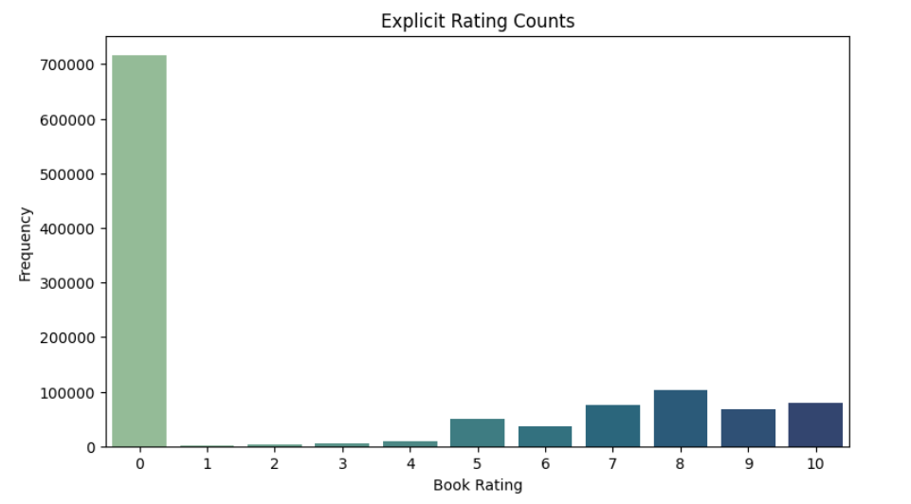
Rating counts
This data shows the frequency of rating(grade) a user provided for the books.
The data shows that most books are rated 0. The 0 rating doesn't always mean the books lack in some aspect but also that the books maybe left unrated.
-If we leave the rating '0' on x-axis the most popular rating chosen was 8. The ratings 1 and 2 are used rarely.
This rating points that most books fall in the 'good' category.
This data can be used to pinpoint what type or what book individually is rated well(is popular). This data can be further grouped according to the features.

Slide 10
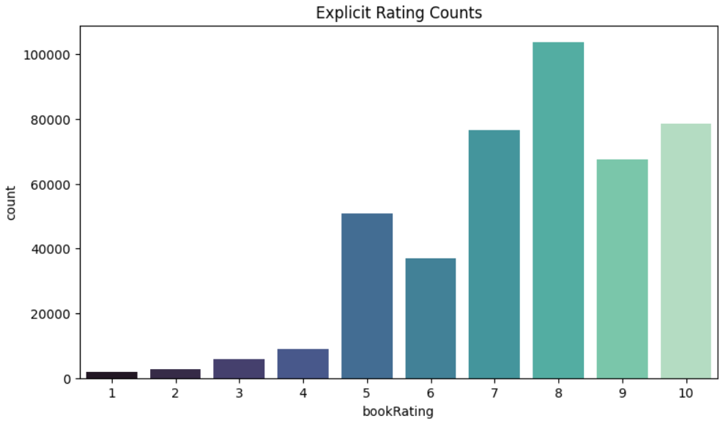
Same count plot as above just without the 0 rating.

Slide 11
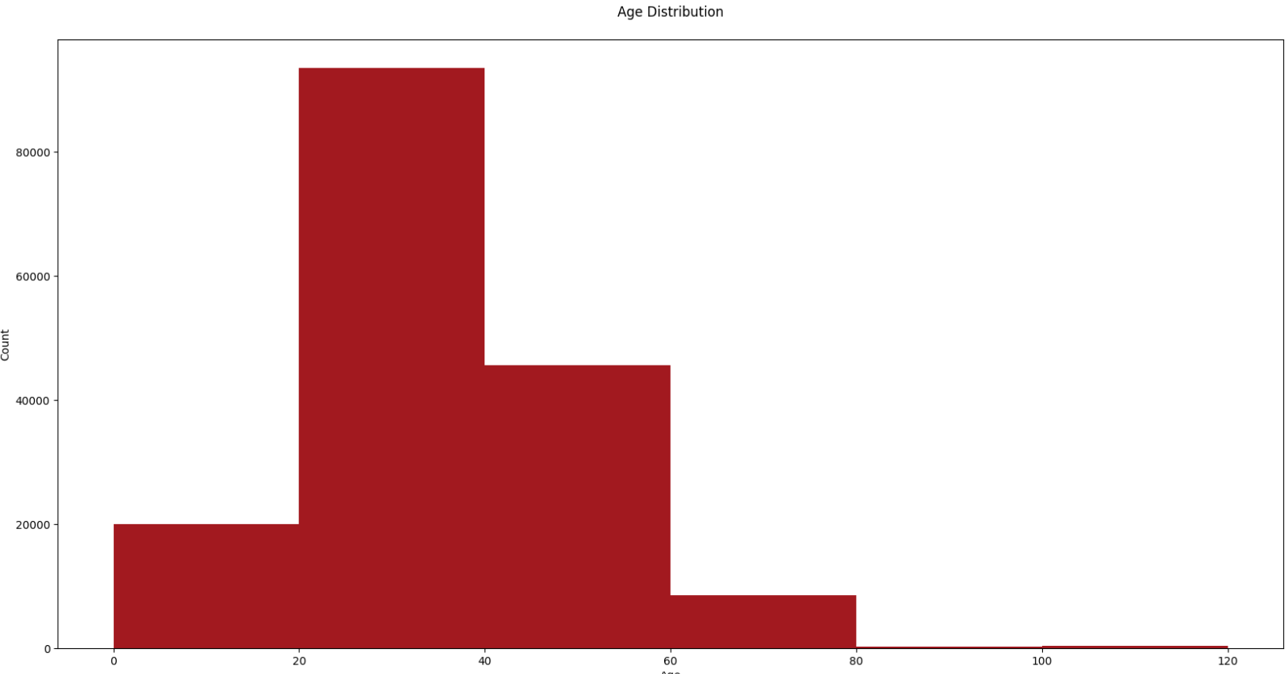
Age Distribution
The Plot above shows the frequency of books bought by buyers(Users) of various age groups.
The data shows that most books are bought by buyers of age group between 20 to 30 [approx.].
The data can be father used to pin point and target the type of books bought by the buyers. Or further group them according to the features in the datasets.

Slide 12
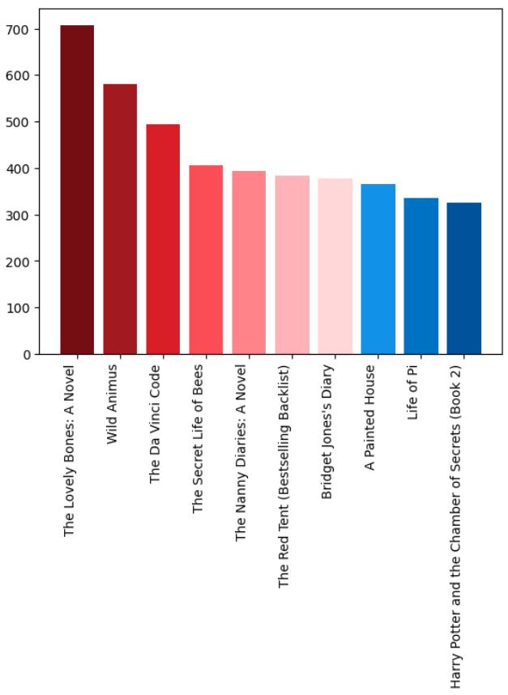
Top 10Books
The plot shows the top 10 books in terms of sales.
The plot shows that The Lovely Bones: A Novel is most popular in terms of Sales.
This data is useful to sort the popular titles in terms of sales. And can be further used for comparison with the local poplars. (Books that are popular in specific regions, Countries and cities.)

Slide 13
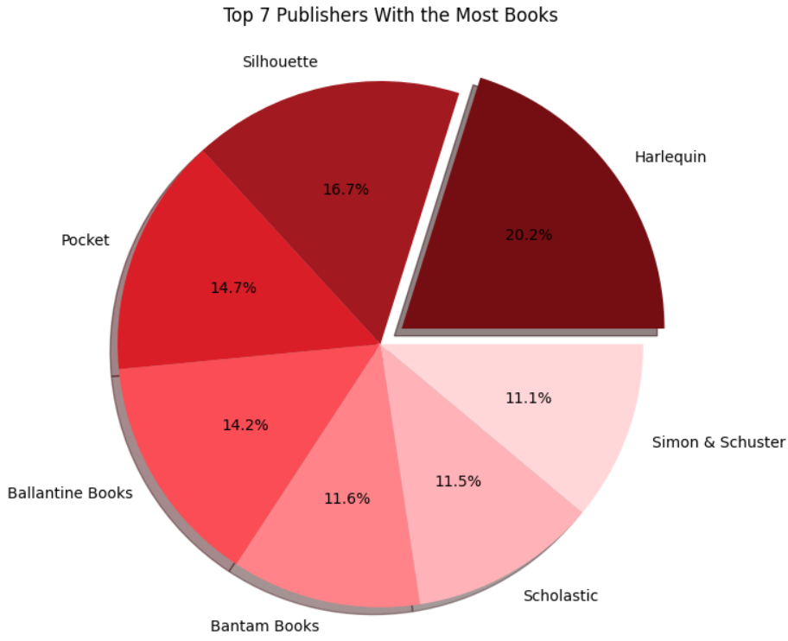
Top 7Publishers with the most books
This pie chart shows the publishers who published most number of books in form of percentage.
The chart shows Harlequin has the highest percentage in number of books published.
- If a user prefers certain publisher then this data can be useful.

Slide 14
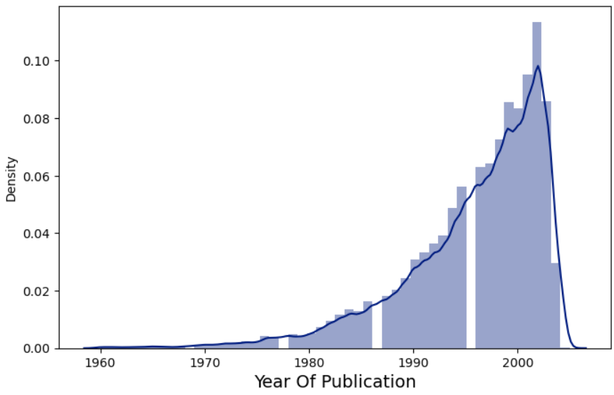
Histogram of the Year of Publication
This chart shows the frequency of books published in a decade.
We can see the highest frequency around the decade of 2000.
This data can be useful if a user prefers books from certain time period or if a certain gerne belongs to a certain time period (for example say the Shakespherian literature).

Slide 15
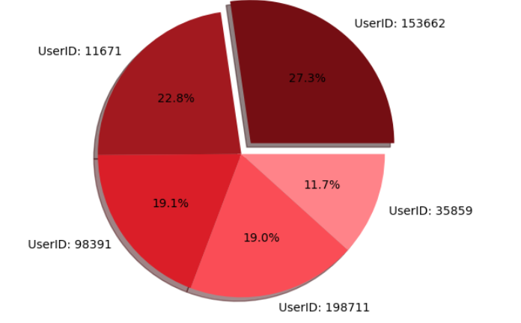
UserIDs With Highest Number Of Rating
This chart shows the userID's with most number of ratings in form of percentage.
This data shows the userID 153662 has the most percentage of ratings i.e. 27.4%
This data shows the most active users and this data can be further used to suggest books to passive or similar users.

Slide 16
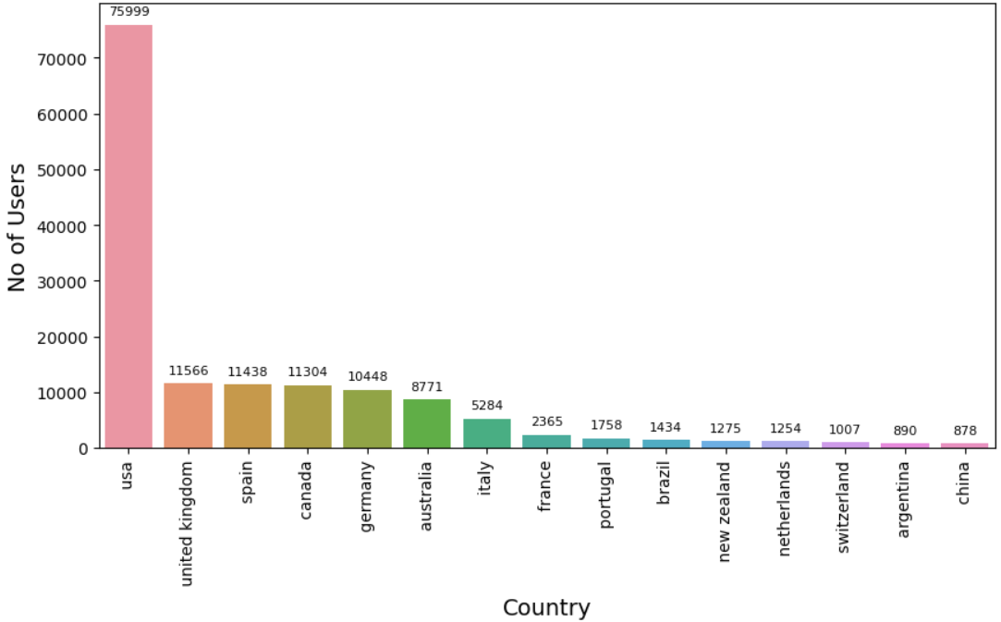
Countries With Most Users
This data shows the countries with most number of users.
USA has most number of users.
This data can be used to target sales in a specific country.

Slide 17
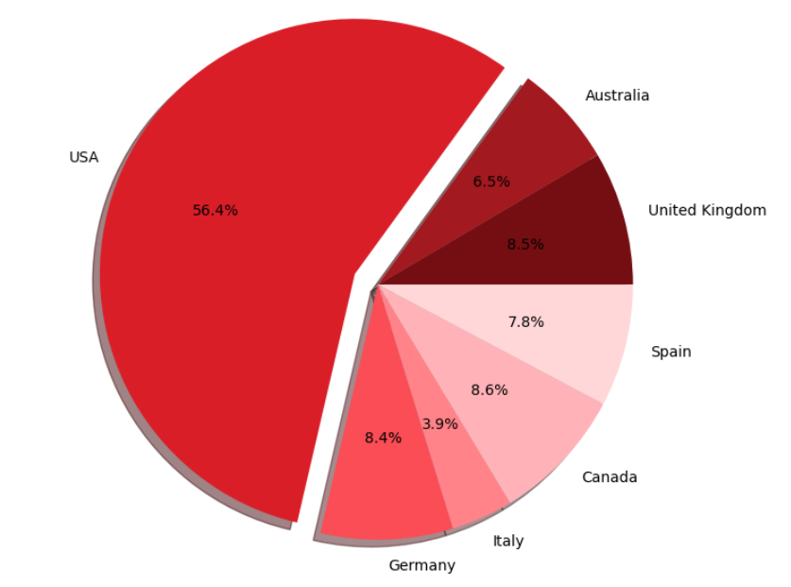
Top 7Countries With the Most Users
This data shows the countries with most number of users.
USA has most number of users i.e. 56.3%
This data can be used to target sales in a specific country.

Slide 18
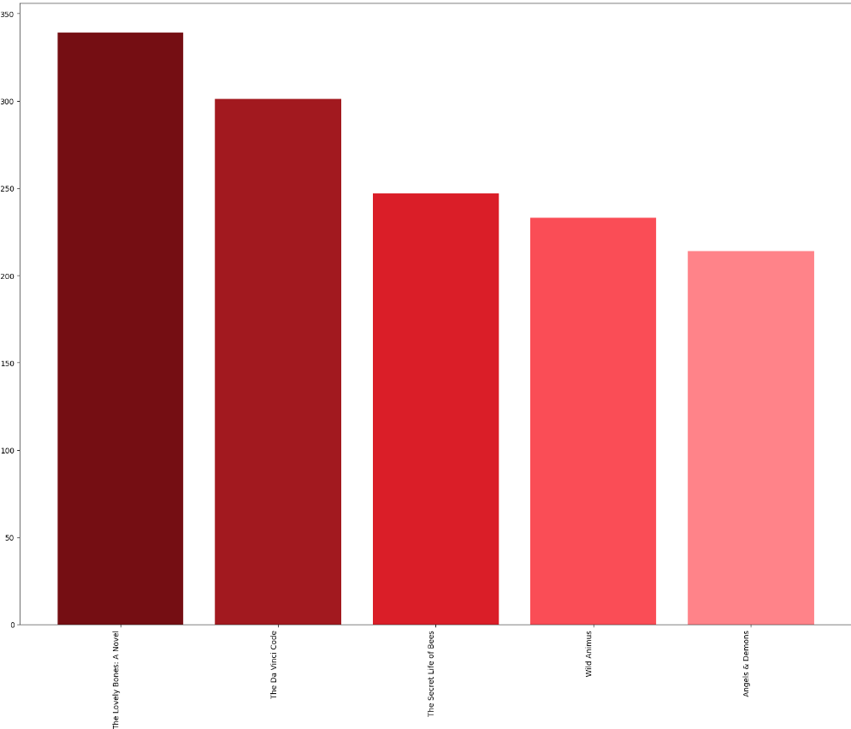
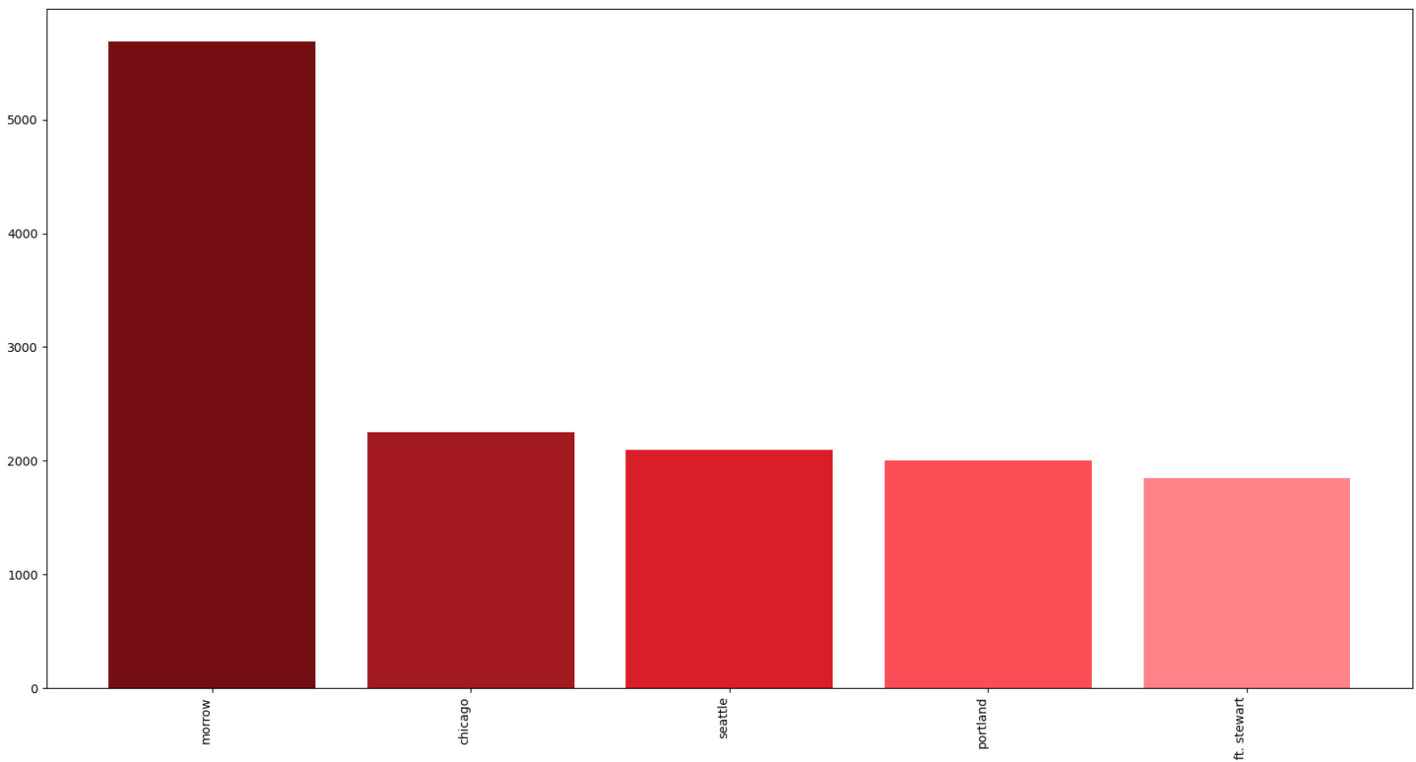
USA
Popular Books
Top cities

Slide 19
Popular Books amongst Kids(Age<=12)
The plot shows the top 10 books in terms of popularity for age group less than 12.
The plot shows that 'Harry Potter and the Sorcerer's Stone (Harry Potter (Paperback))' is most popular in terms of popularity.
This data is useful to sort the popular titles in terms of popularity amongst kids(Age<=12). And can be further used for comparision with the local populars for kids. (Books that are popular in specific regions, Countries and cities.)

Slide 20
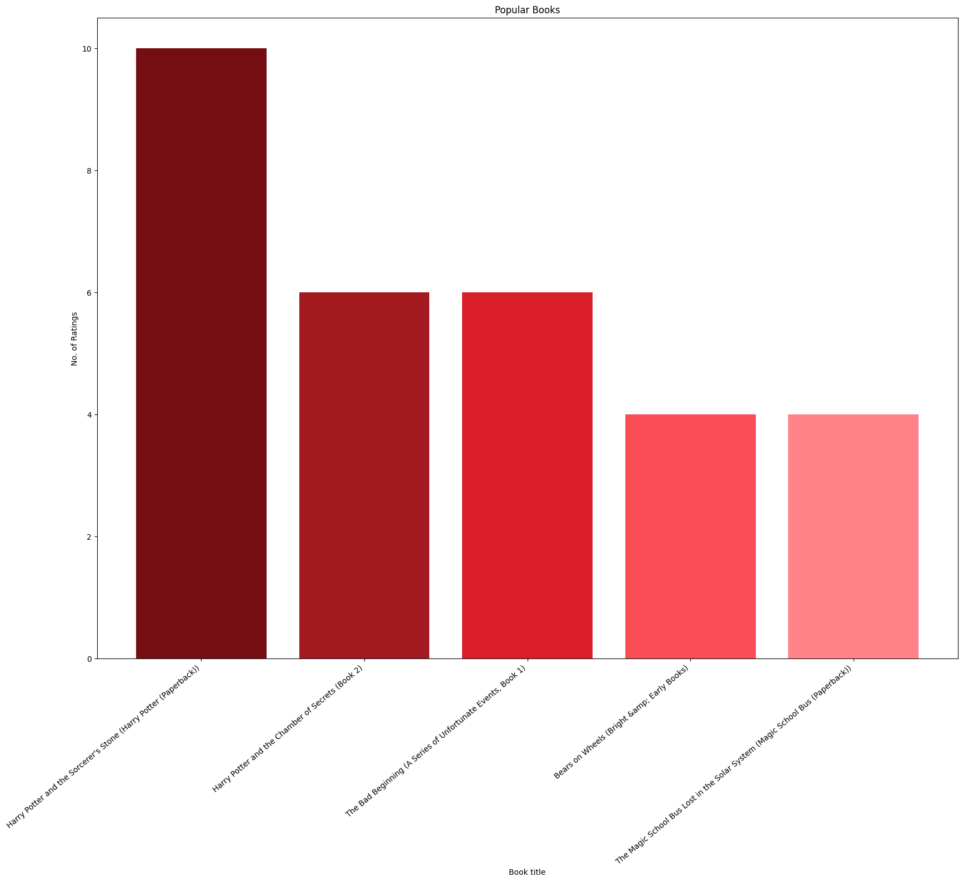

Slide 21
Popular Books amongst Teens(12<=Age<18)
The plot shows the top 10 books in terms of popularity for age group between 13 to 18 (teenagers).
The plot shows that 'Wild Animus' is most popular in terms of popularity.
This data is useful to sort the popular titles in terms of popularity amongst teenagers. And can be further used for comparisons with the local populars for teenagers. (Books that are popular in specific regions, Countries and cities.)

Slide 22
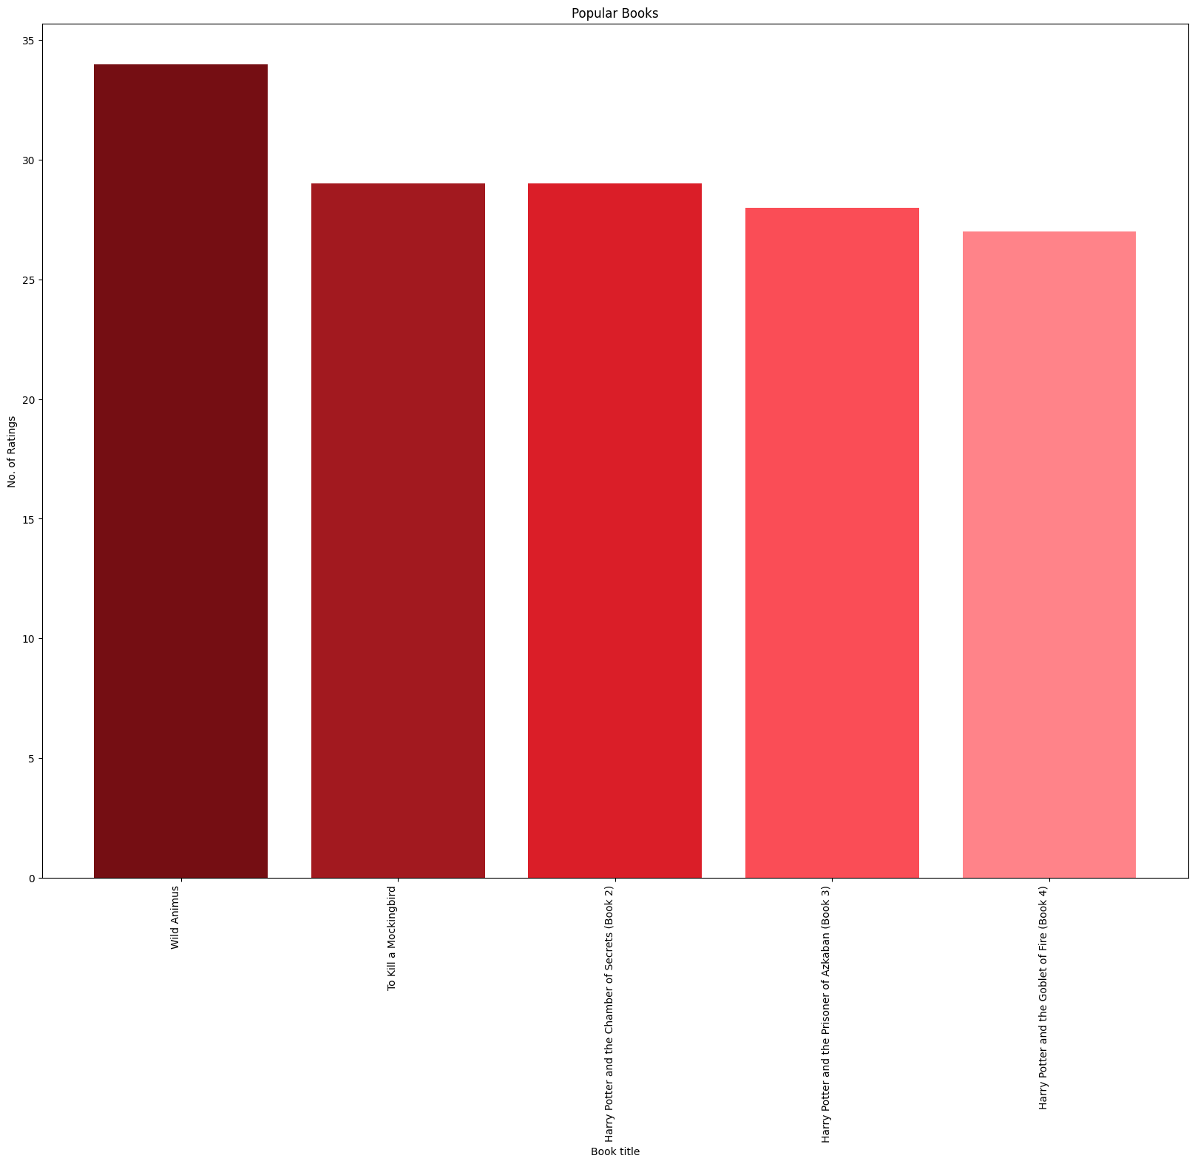

Slide 23
Popular Books amongst Young Adults (18<=Age<39)
The plot shows the top 10 books in terms of popularity for age group between 18 and 39 (young adults).
The plot shows that 'The Lovely Bones: A Novel' is most popular in terms of popularity.
This data is useful to sort the popular titles in terms of popularity amongst young adults. And can be futher used for comparision with the local populars for young adults. (Books that are popular in specific regions, Countries and cities.)

Slide 24
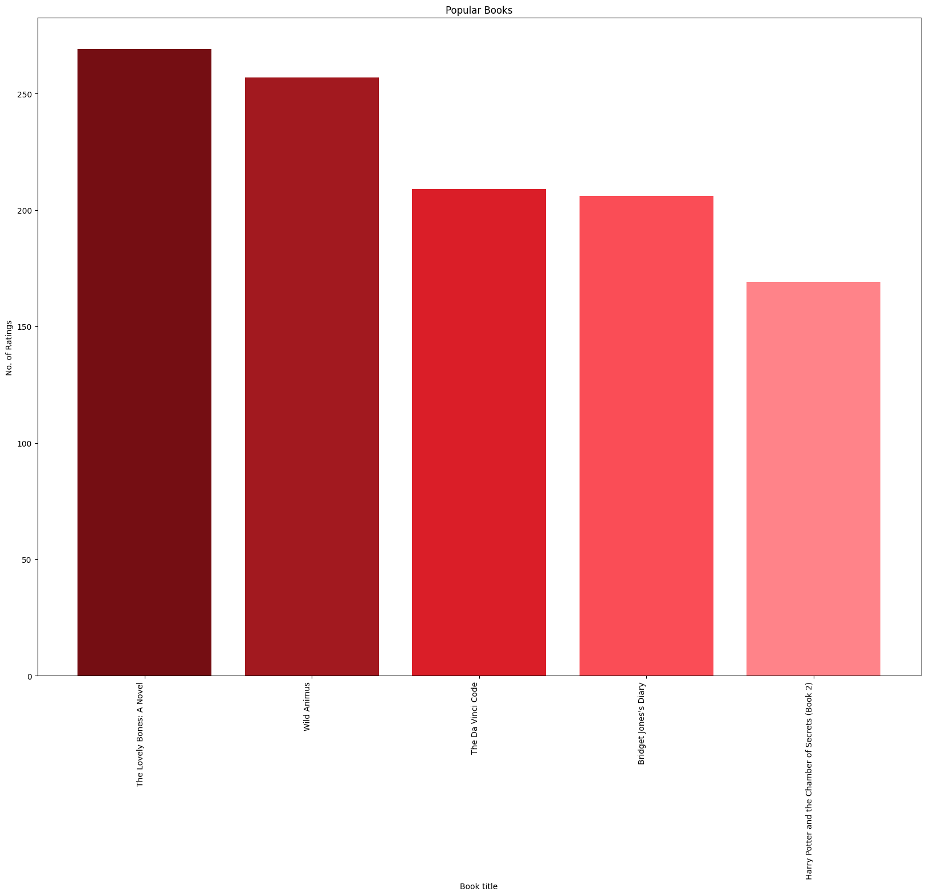

Slide 25
Popular Books amongst Middle-Aged Adults (39<=Age<60)
The plot shows the top 10 books in terms of popularity for age group between 18 and 39 (young adults).
The plot shows that 'The Lovely Bones: A Novel' is most popular in terms of popularity.
This data is useful to sort the popular titles in terms of popularity amongst young adults. And can be further used for comparisons with the local populars for young adults. (Books that are popular in specific regions, Countries and cities.)

Slide 26
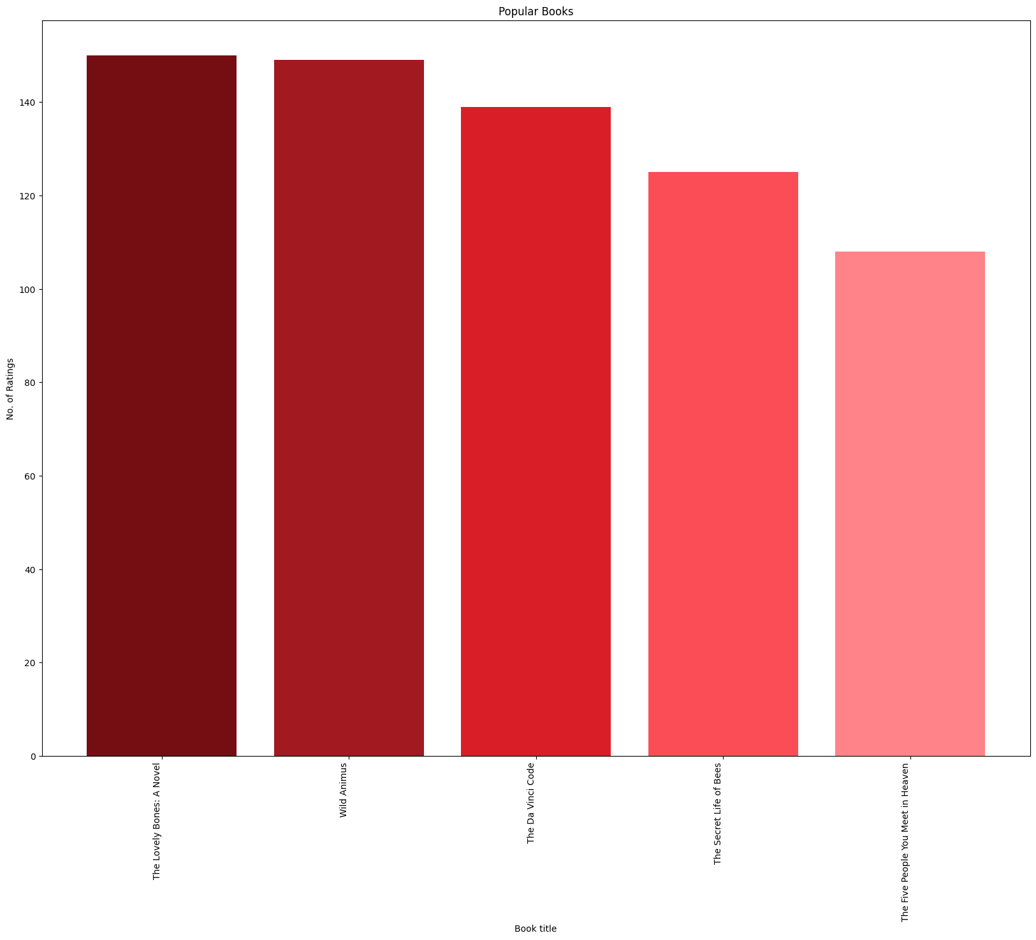

Slide 27
Popular Books amongst Senior Citizens Adults (Age>60)
The plot shows the top 10 books in terms of popularity for age group above 60 (senior citizens).
The plot shows that 'The Lovely Bones: A Novel' is most popular in terms of popularity.
This data is useful to sort the popular titles in terms of popularity amongst senior citizens. And can be further used for comparisons with the local populars for senior citizens. (Books that are popular in specific regions, Countries and cities.)

Slide 28
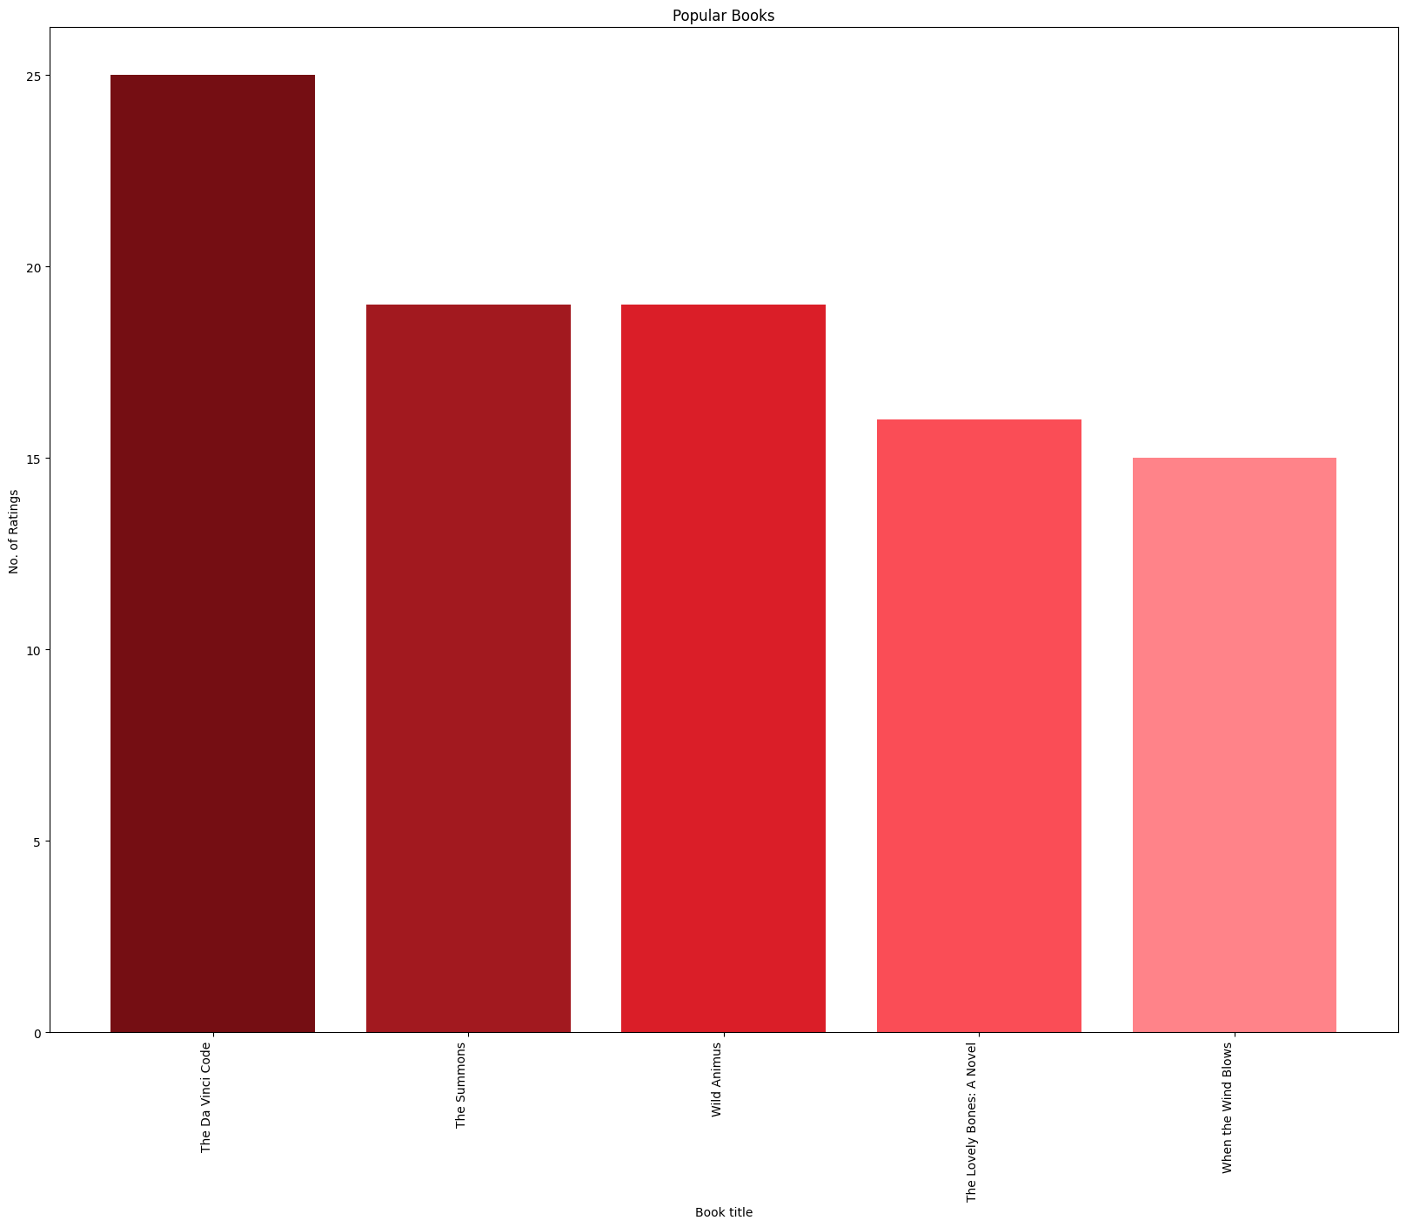

Slide 29

All three datasets are cleaned separately

Slide 30

Books
Dropped three images URL features.
Checked for the number of null values in each column. replace these three empty cells with Other
Checked for the unique years of publications
Checked duplicates values

Slide 31

Users
Checked null values in the table
Checked for unique values present in the Age columns . There are many invalid age
Checked for unique values present in the Age Column. There are many invalid ages present
The Location column has 3 values city, state and country. these are split into different columns named; City, State and Country respectively . In the case of null value , ‘other’ has been assigned as the entity values.
Removed duplicate entries from the table.

Slide 32


Ratings
Checked for null values in the table
Checked for rating columns and Users-ID columns to be an integer
Removed duplicate entries from the table

Slide 33
User-Based Model

Slide 34
Introduction
User-based collaborative filtering is also called user-user collaborative filtering. It is a type of recommendation system algorithm that uses user similarity to make product recommendations.
User-based collaborative filtering makes recommendations based on user-product interactions in the past. The assumption behind the algorithm is that similar users like similar products.

Slide 35
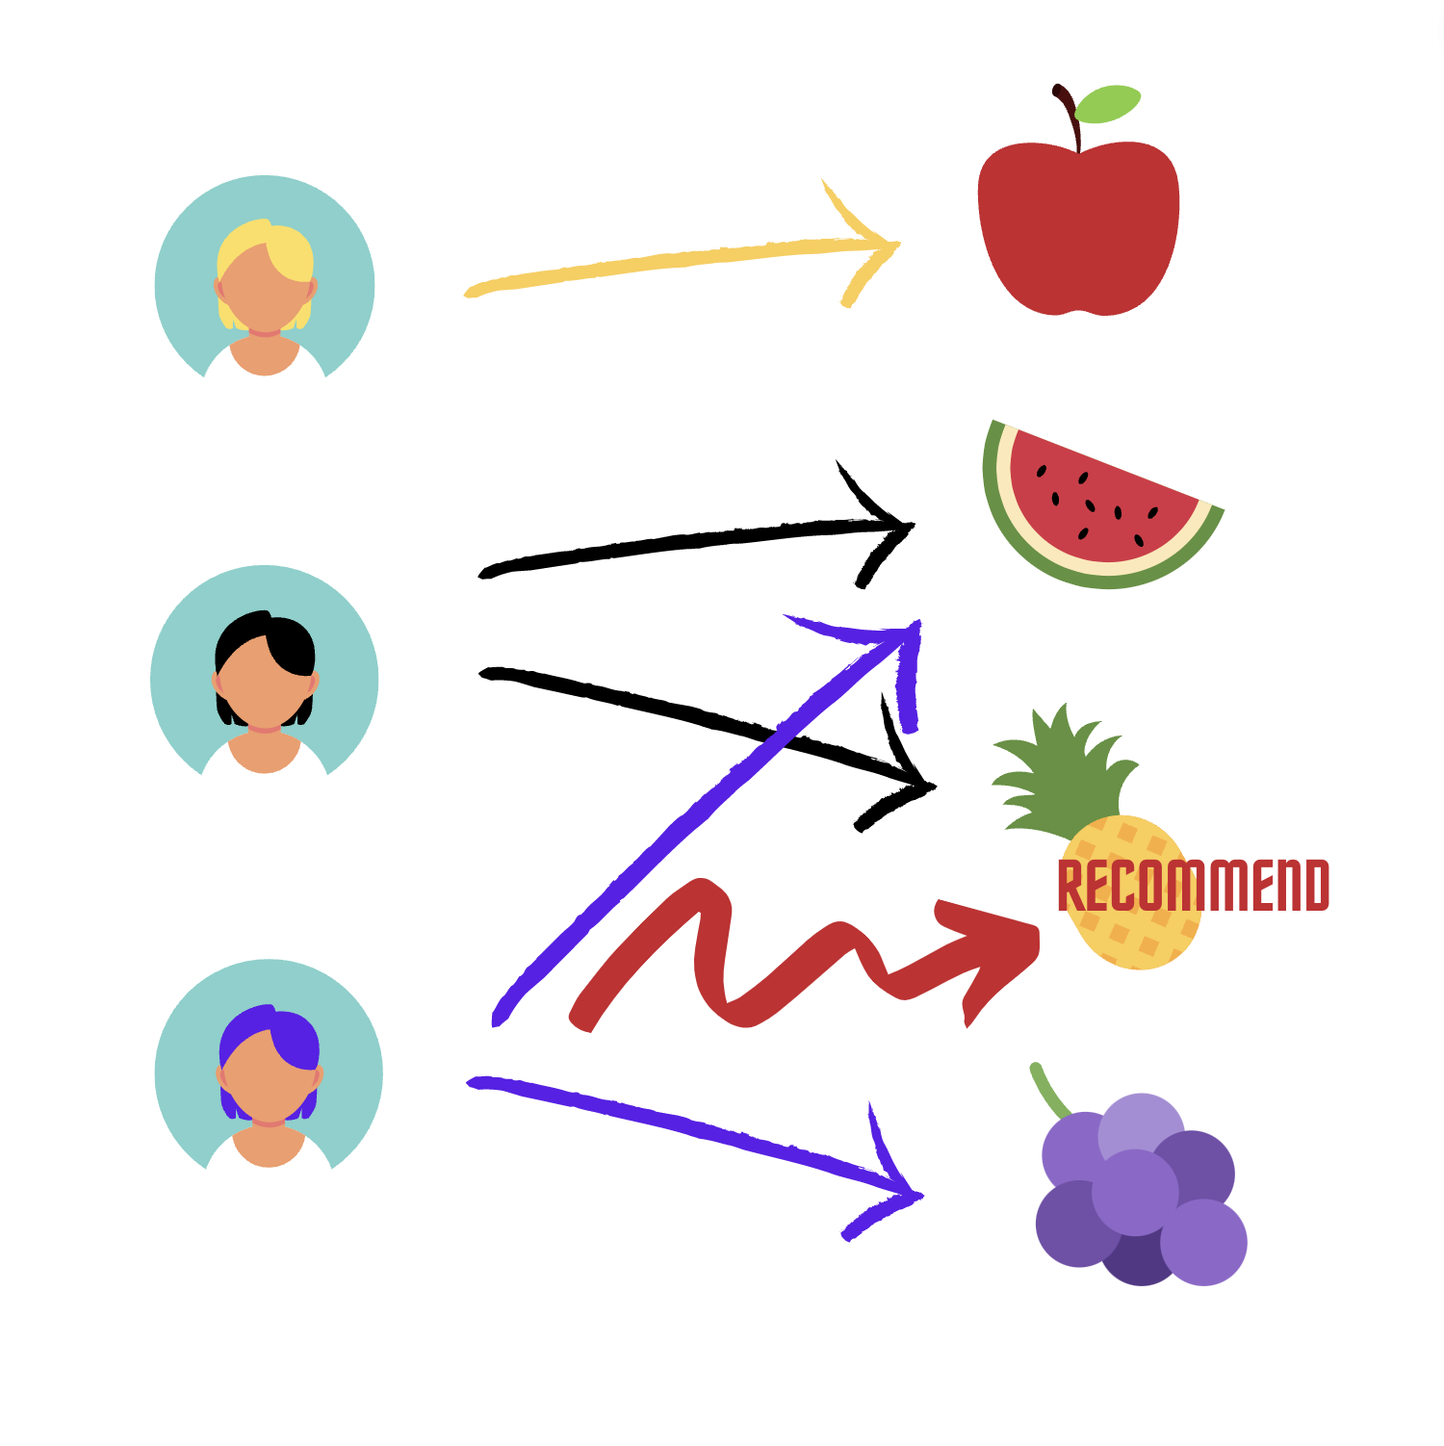

Slide 36
Introduction
User-based collaborative filtering algorithm usually has the following steps:
Find similar users based on interactions with common items.
Identify the items rated high by similar users but have not been exposed to the active user of interest.
Calculate the weighted average score for each item.
Rank items based on the score and pick top n items to recommend.

Slide 37
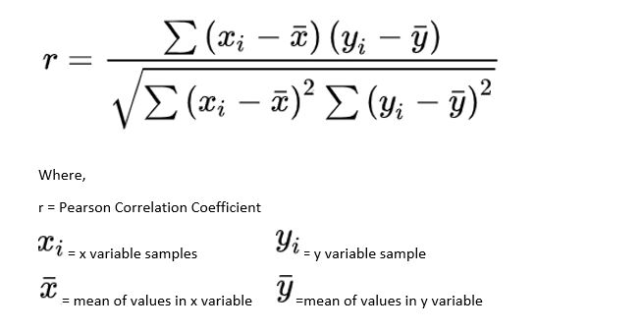
Introduction
Steps for User-Based Collaborative Filtering:
Step 1: Finding the similarity of users to the target user U. Similarity for any two users ‘x’ and ‘y’ can be calculated from the given formula,

Slide 38
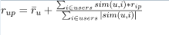
Introduction
Steps for User-Based Collaborative Filtering:
Step 2: Prediction of missing rating of an item Now, the target user might be very similar to some users and may not be much similar to others. Hence, the ratings given to a particular item by the more similar users should be given more weightage than those given by less similar users and so on. This problem can be solved by using a weighted average approach. In this approach, you multiply the rating of each user with a similarity factor calculated using the above mention formula. The missing rating can be calculated as:

Slide 39
Model Deployment
In this project we are deploying the model using streamlit

Slide 40
Streamlit
We are using Streamlit to deploy the model
We created the architecture of the web Application using Streamlit methods
We recommended the books based on user-user similarity and displayed the recommended books using the booktitle, author and the coverpage image

Slide 41
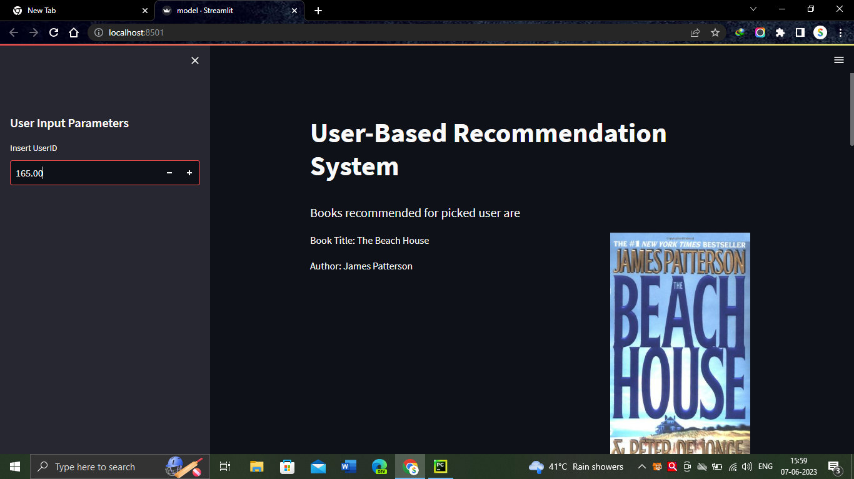
Web Interface

Slide 42
Thank You

